Slide 1
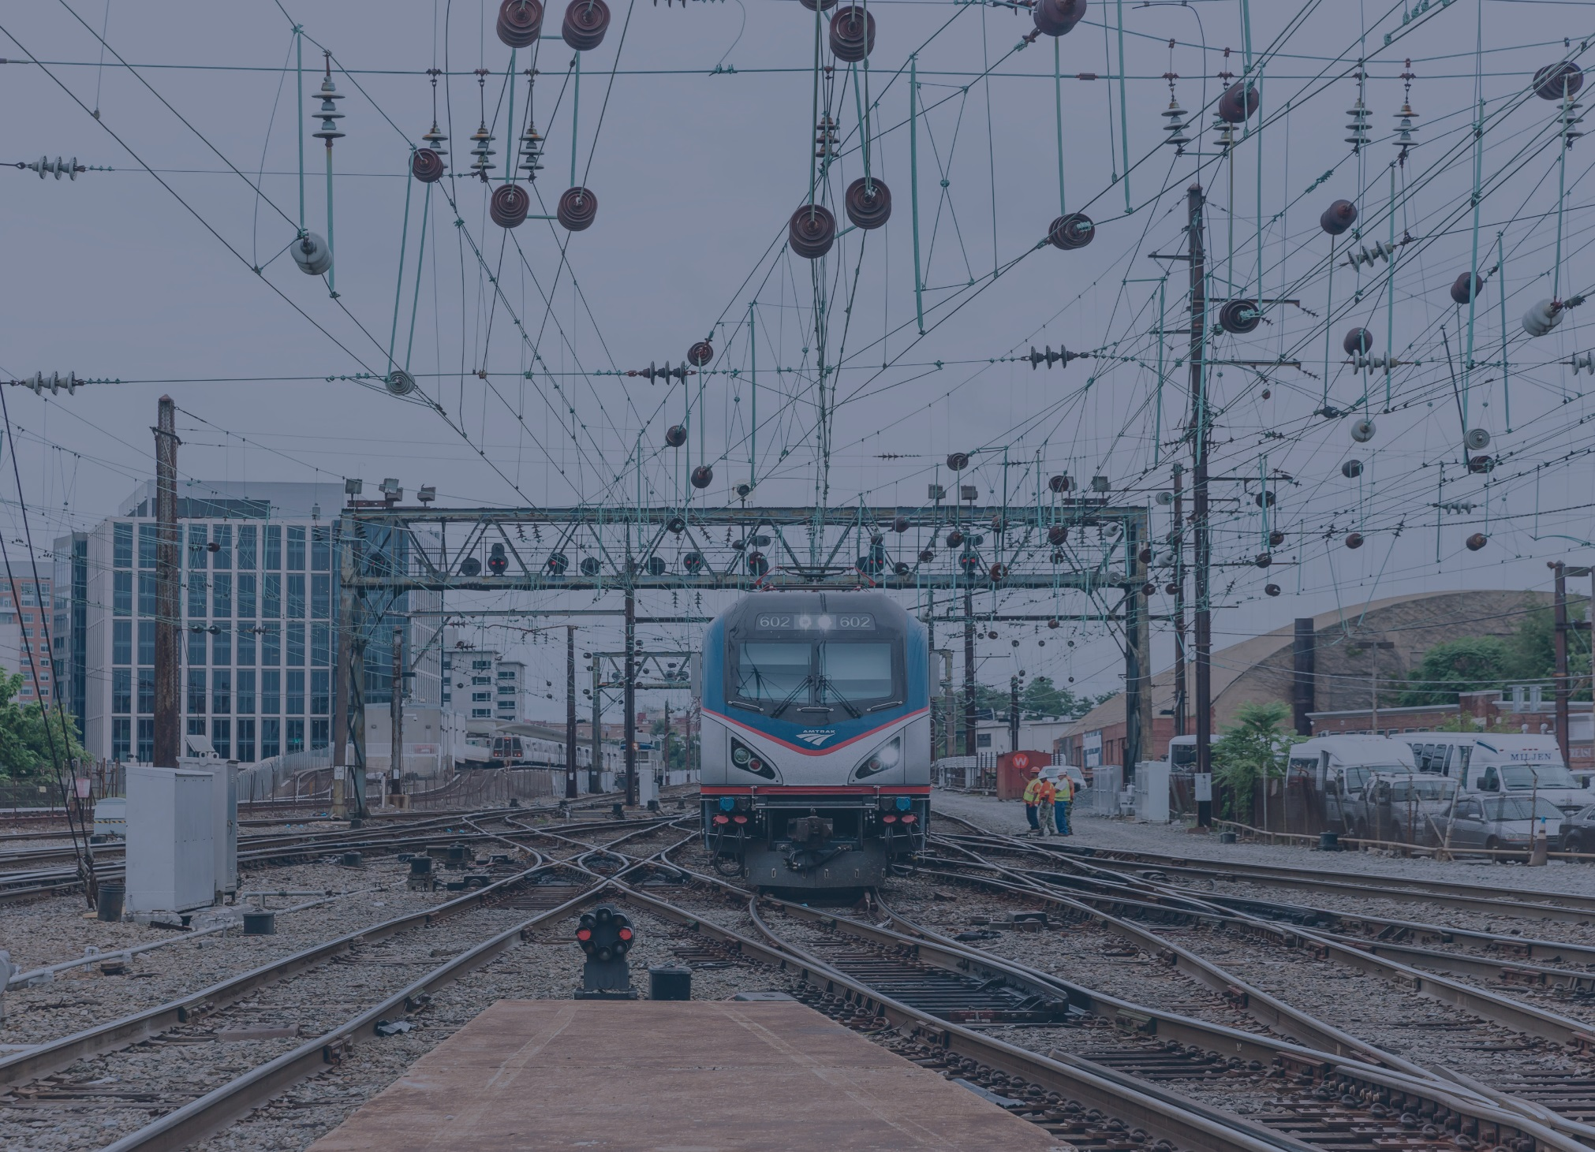

OVERVIEW:
POSITIVE TRAIN CONTROL (ptc)
December 2017

Slide 2
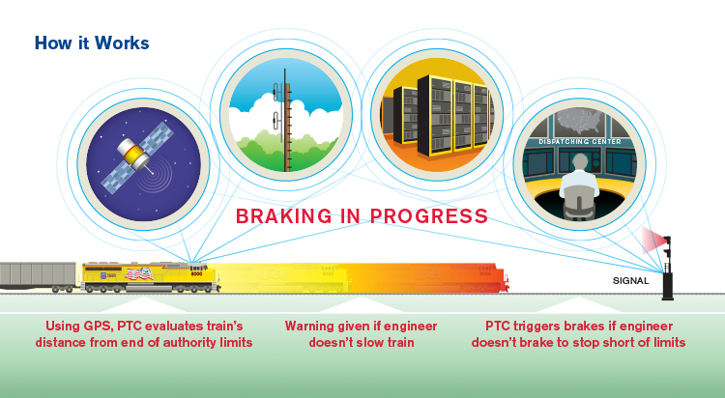
Positive Train Control
WHAT IS PTC?
PTC is a technology capable of automatically controlling train speeds and movements, should a train operator fail to take appropriate action in the prevailing conditions.
HOW IT WORKS
For example, PTC can force a train to stop before it passes a signal displaying a stop indication, or before running through an improperly lined switch, averting a potential collision.

Slide 3
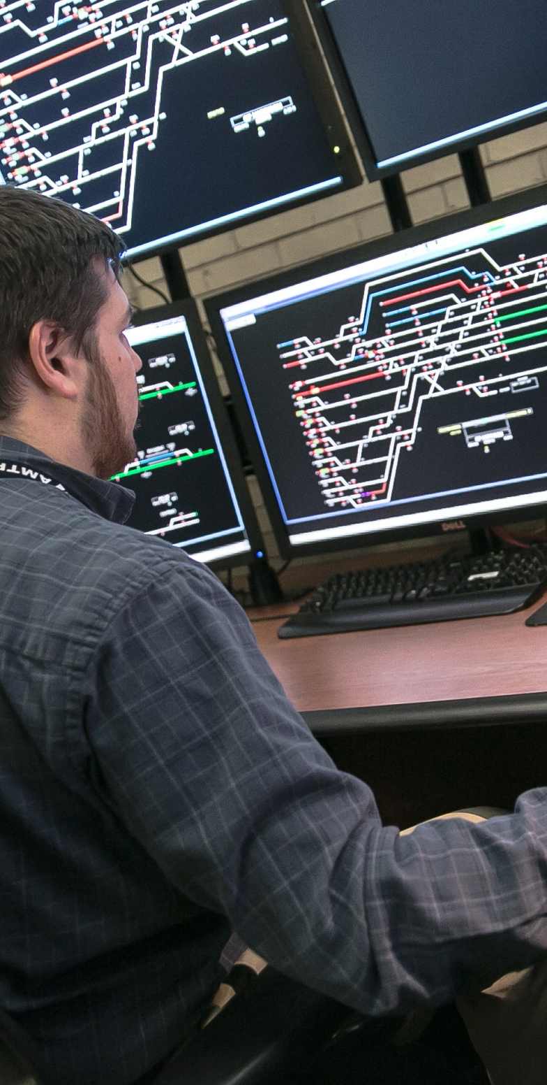
Positive Train Control
WHAT DOES PTC DO?
PTC systems that meet the standards set by FRA regulations are required to reliably and functionally prevent:
Train-to-train collisions;
Over speed derailments;
Incursion into an established work zone; and
Movement through a main line switch in the improper position.
Other functions are applicable within the requirements as specific conditions warrant.
An Amtrak train director monitors the Chicago Union Station control center.

Slide 4
Positive Train Control
WHAT IS THIS HISTORY OF PTC?
How did we get here…
1990s – 2000s
Amtrak undertakes pioneering U.S. installations of PTC on portions of the Northeast Corridor and Amtrak’s Michigan Line. Interest in PTC continues to grow as passenger and transit ridership rise.
1990s – 2000s
While some railroads make progress on PTC installation, others do not – costs and technical challenges are cited as reasons.
OCT 2015
Congress extends PTC implementation deadline to December 31, 2018:
All Class 1 railroads, intercity passenger railroads, and commuter railroads required to implement PTC (where called for by FRA regulation).
Possibility of two additional years if certain requirements are met.
FRA starts collecting progress implementation data from railroads shared that data with the public.
1920s-1940s
Primitive automatic train stop systems enter service in some places.
HOW DID WE GET HERE?
1920s - 1940s
1960s - 1970s
1990s - 2000s
2008
2008 - 2015
MAY 2015
OCT 2015
DEC 2015
1990s – 2000s
Interest in PTC grows.
DEC 2017
Amtrak Tacoma incident.
1990s – 2000s
Chatsworth collision; Congress passes bill requiring PTC by December 2015.
MAY 2015
Frankfurt Junction derailment in Philadelphia – deemed “PTC preventable.”

Slide 5
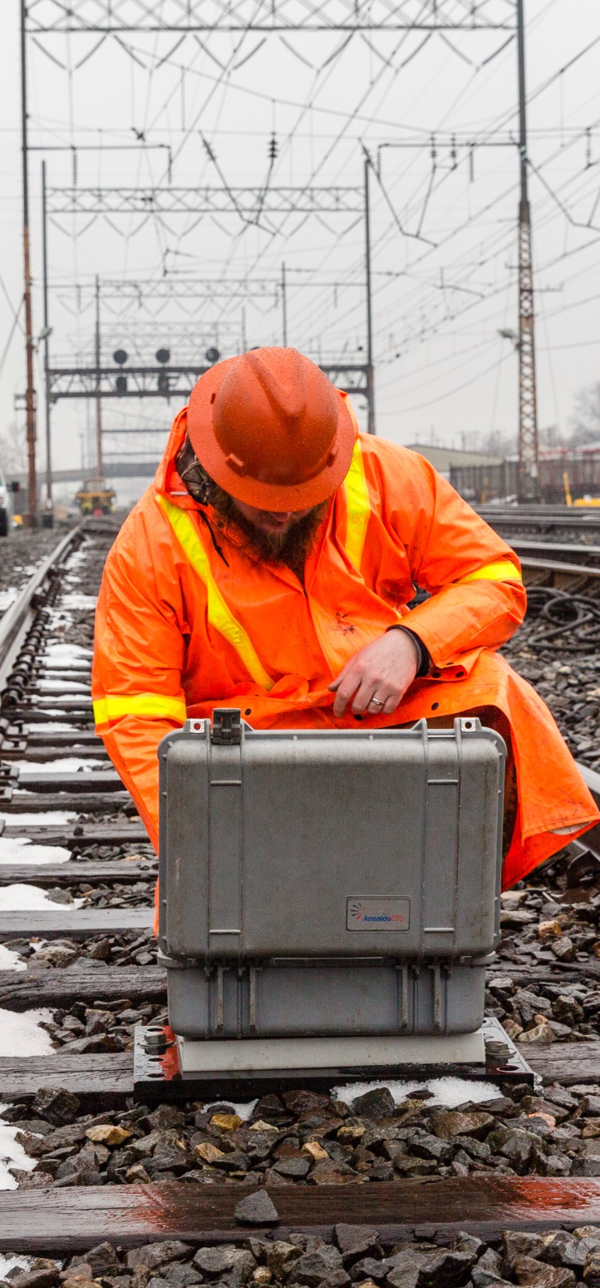
Positive Train Control
AMTRAK AND PTC
For Amtrak’s purposes, there are 2 types of PTC
  PTC technologies that we own/operate and have installed on our infrastructure
  PTC technologies that have been chosen by other carriers for their infrastructure that Amtrak’s locomotives and cab cars must operate and communicate with
Amtrak’s PTC = ACSES, ITCS
  Approved by FRA, provide all elements of PTC
  In use on the NEC (ACSES) and Michigan Line (ITCS)
Freight carriers’ and some other commuter RRs’ PTC = IETMS
  Class I freight carriers and many commuter trains use the Interoperable Electronic Train Management System (I-ETMS).
  I-ETMS provides all the elements required for PTC
An Amtrak technician resetting a PTC transponder in Delaware along the Northeast Corridor.

Slide 6



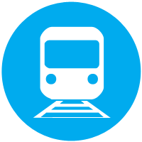

Positive Train Control
WHO IS RESPONSIBLE FOR PTC INSTALLATION?
Component
Responsible Party
  PTC
  Infrastructure
Rail infrastructure owner, FRA
  Infrastructure system back office server
Rail infrastructure owner
  Testing
Rail infrastructure owner, FRA
  Locomotive and onboard systems
Equipment owner
  Back office servers
Shared; host railroads require back office server, Amtrak and other operators also needs one to communicate with multiple host servers
Component | Responsible Party
PTC Infrastructure | Rail infrastructure owner
Infrastructure system back office server | Rail infrastructure owner
Testing | Rail infrastructure owner, FRA
Locomotive and onboard systems | Equipment owner
Back office servers | Shared; host railroads require a back office server, Amtrak also needs one to communicate with multiple host servers

Slide 7

Positive Train Control
CONCLUSION
Responsibility for PTC is shared among parties, sometimes complicating implementation, but all parties are working towards the same goal.
Installing PTC is one component of Amtrak’s overarching commitment to the safety of our customers and employees and the communities we serve.
Continued Congressional support is needed to ensure that Amtrak and commuter railroad PTC costs are funded.

Slide 8
APPENDIX:
Technical Systems

Slide 9
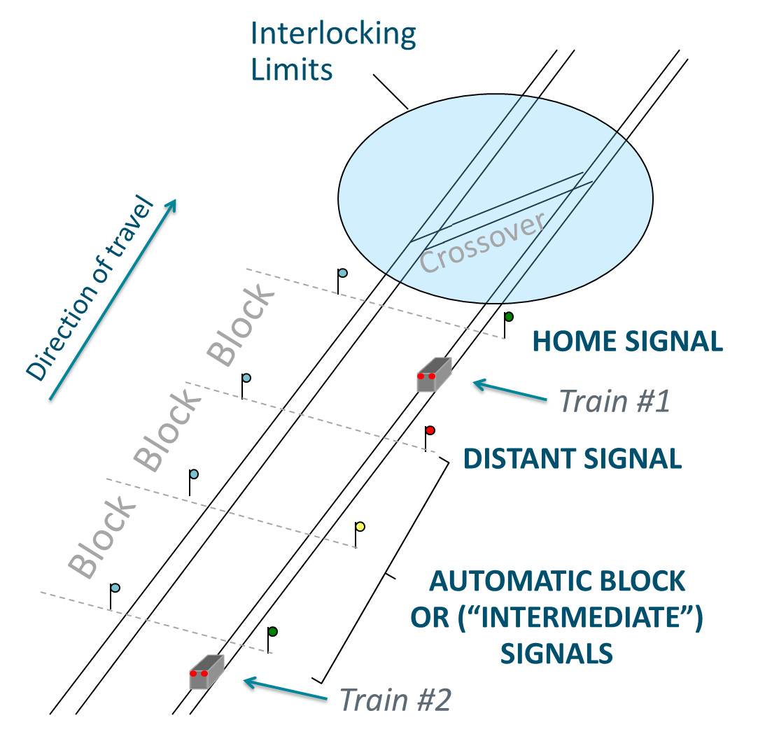
Positive Train Control
TRACKSIDE SIGNAL SYSTEM
ABS, CTC and Interlockings
Intermediate (ABS) signals operate automatically:
  Detect presence of a train using “track circuits”
  Activates two signals behind the train to protect it:
    Approach signal
    Stop signal
Interlockings are controlled remotely
by dispatchers:
  This system of remote control is called “Centralized Traffic Control,” (CTC for short)
  Complex of signals and switches electronically “interlocked”
  Impossible to “line” an
  unsafe route
Clear signals permit engineers to operate the train at maximum authorized speeds.

Slide 10
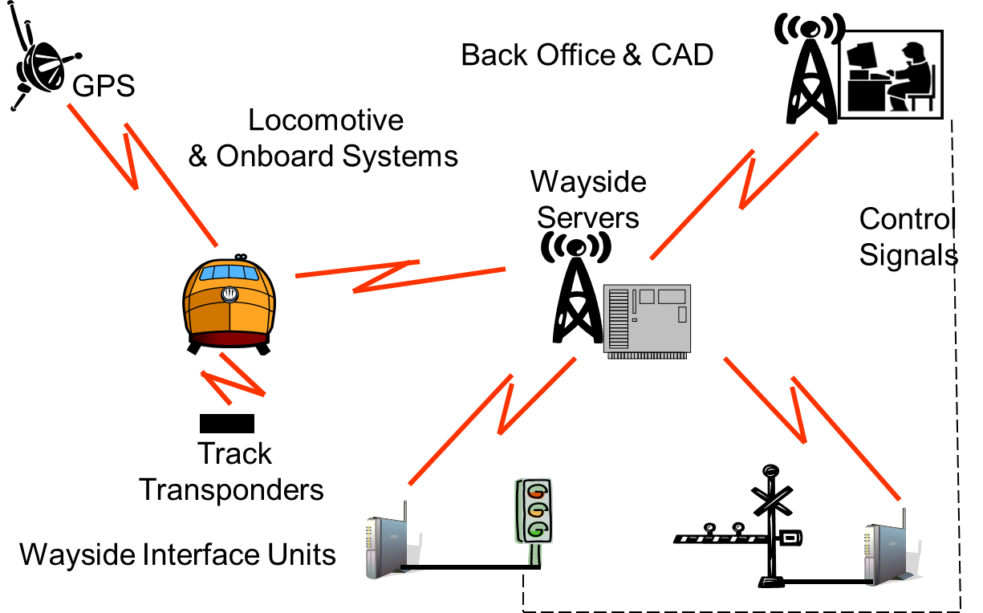
Positive Train Control
I-ETMS ARCHITECTURE
Interoperable Electronic Train Management System (I-ETMS):
I-ETMS is designed to:
  Prevent train-to-train collisions
    Enforcing stop signals
    Enforcing “authority limits” (i.e., track a train has permission to occupy)
  Prevent trains from derailing through excessive speed
  Prevent trains from entering work zones without proper authorization
  Prevent movement through an improperly set switch in the main track
  Provide warning and enforcement at a derail or switch providing access to a main track
  Provide warning and enforcement in the event of a highway-rail grade crossing warning device malfunction
  Provide warning and enforcement for a mandatory directive associated “After Arrival Of” train movements
SOURCE: FEDERAL RAILROAD ADMINISTRATION
I-ETMS adds an overlay system to enforce the existing signal indications and civil speed restrictions

Slide 11
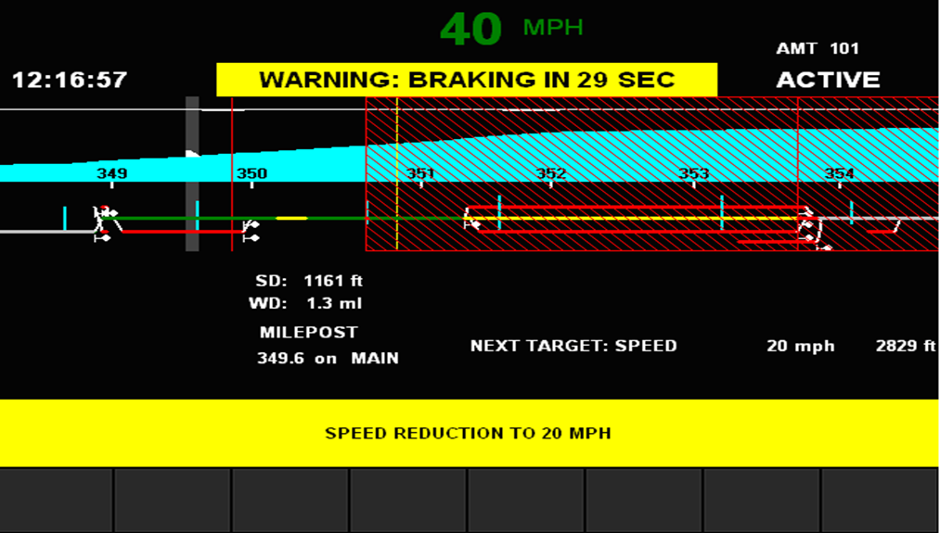
Positive Train Control
PREDICTIVE SPEED ENFORCEMENT
If a train comes within Warning Distance of a speed restriction, and I-ETMS predicts train speed will exceed speed limit by 5mph or more when the train enters the restriction, a “Speed Reduction To XX mph” message will display along with the time remaining to enforcement braking.
If the engineer takes no action, computer will apply the brakes at the appropriate time, bringing the train to a stop.
Engineer will not be able to recover from a “penalty application” until the train has stopped.

Slide 12
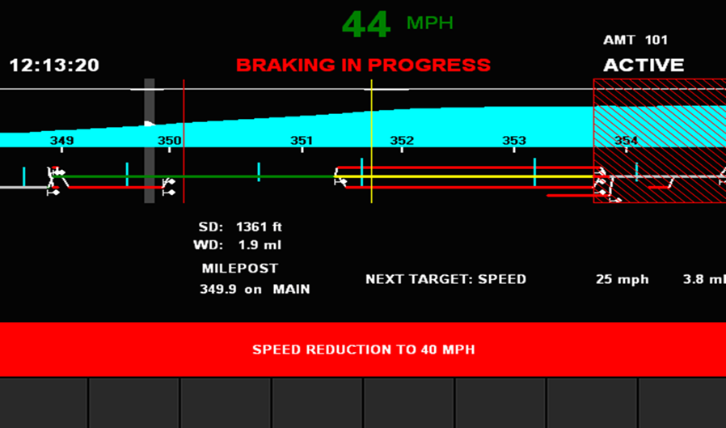
Positive Train Control
REACTIVE SPEED ENFORCEMENT
If a train exceeds maximum speed allowed for the track by 3 mph,
I-ETMS will display a warning to indicate the train is over speed and a “Maximum Speed Is xx MPH” message.
If the train exceeds the maximum speed allowed for the speed of the current location by at least 5 mph, I-ETMS will apply the brakes and display the “Maximum Speed Is xx MPH” message.
If a penalty brake application occurs, the train MUST be stopped before recovery is permitted.

Slide 13
FOR ADDITIONAL INFORMATION VISIT: media.amtrak.com

